Slide 1
Cardinality Countably Infinite Countability via Sequences Larger Infinities
Lecture 9: Cardinality
Aaron Tan
Part of the contents here is taken from Dr Wong Tin Lok’s lecture notes.
AY2022/23 Semester 1

Slide 2

Cardinality Countably Infinite Countability via Sequences Larger Infinities
Aaron arrives at Hawaii for a long overdue vacation late one night. Tired, he walks into the famous Hilbert’s Hotel looking for a room with a comfortable bed for a good night rest. Unfortunately, the hotel is already full. However, fortunately, the night manager has a clever idea…
Hilbert’s Infinite Hotel:
https://www.youtube.com/watch?v=Uj3_KqkI9Zo

Slide 3
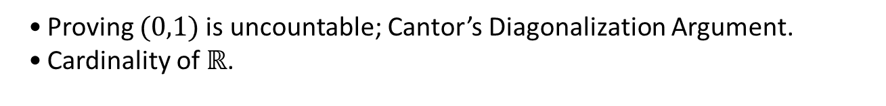
Cardinality Countably Infinite Countability via Sequences Larger Infinities
9. Countability
9.1 Cardinality
Pigeonhole principle; dual pigeonhole principle.
9.2 Countably Infinite
Definition of countably infinite; countable and uncountable sets.
Proving $\left|2ℤ\right|=|ℤ|$.
Proving |2ℤ|=|ℤ|.
Proving $ℤ$ , $ℚ^{+}$ , and $ℤ^{+}{×ℤ}^{+}$ are countable.
Proving ℤ , ℚ^+ , and ℤ^+ 〖×ℤ〗^+ are countable.
9.3 Countability via Sequences
Cartesian product; general Cartesian product, unions.
Finite and infinite sets; cardinality; Cantor’s definition of same cardinality.
Countability and sequences.
9.4 Larger Infinities
Proving $(0,1)$is uncountable; Cantor’s Diagonalization Argument.
Cardinality of $ℝ$.
Reference: Epp’s Chapter 7 Section 7.4

Slide 4
Cardinality Countably Infinite Countability via Sequences Larger Infinities
9.1 Cardinality

Slide 5

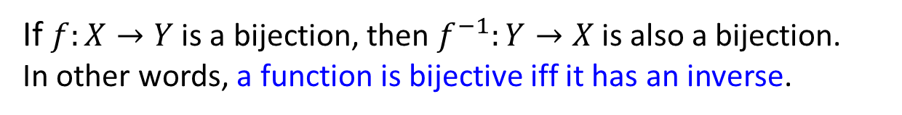
Cardinality Countably Infinite Countability via Sequences Larger Infinities
Pigeonhole Principle
9.1.1 Pigeonhole Principle
Definitions: Injection, surjection, bijection, inverse function
Let $X$ and $Y$ be sets and $f:X→Y$ be a function.
$f$ is injective iff $∀x_{1},x_{2}∈X \left(f\left(x_{1}\right)=f\left(x_{2}\right)⇒x_{1}=x_{2}\right)$.
$f$ is surjective iff $∀y∈Y ∃x∈X \left(y=f\left(x\right)\right)$.
$f$ is bijective iff $f$ is injective and bijective, that is, $∀y∈Y ∃!x∈X \left(y=f\left(x\right)\right).$
$g:Y→X$ is an inverse of $f$ (also denoted as $f^{−1}$) iff $∀x∈X ∀y∈Y \left(y=f\left(x\right)⇔x=g\left(y\right)\right).$
Theorem 7.2.3
If $f:X→Y$ is a bijection, then $f^{−1}:Y→X$ is also a bijection.
In other words, a function is bijective iff it has an inverse.

Slide 6
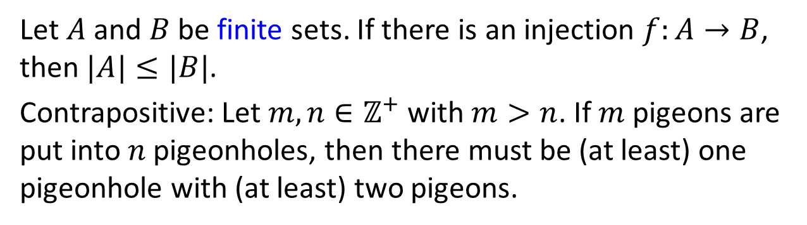
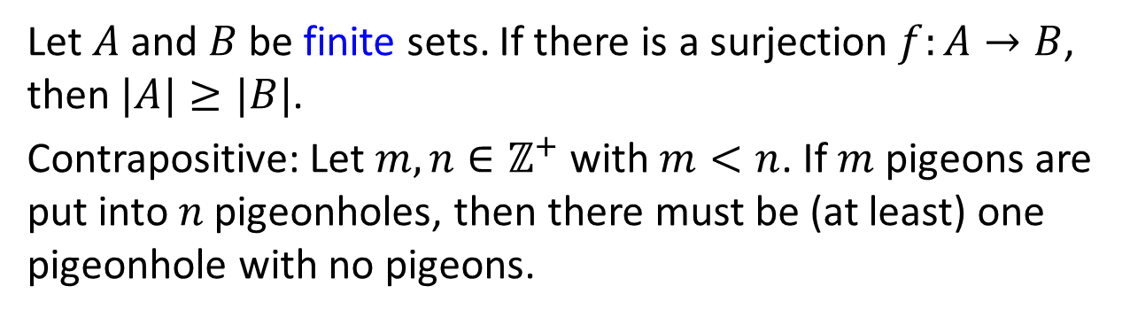
Cardinality Countably Infinite Countability via Sequences Larger Infinities
Pigeonhole Principle
What injections and surjections tell us about cardinality.
Pigeonhole Principle
Let $A$ and $B$ be finite sets. If there is an injection $f:A→B$, then $|A|≤|B|$.
Contrapositive: Let $m,n∈ℤ^{+}$ with $m>n$. If $m$ pigeons are put into $n$pigeonholes, then there must be (at least) one pigeonhole with (at least) two pigeons.
Dual Pigeonhole Principle
Let $A$ and $B$ be finite sets. If there is a surjection $f:A→B$, then $|A|≥|B|$.
Contrapositive: Let $m,n∈ℤ^{+}$ with $m<n$. If $m$ pigeons are put into $n$pigeonholes, then there must be (at least) one pigeonhole with no pigeons.

Slide 7
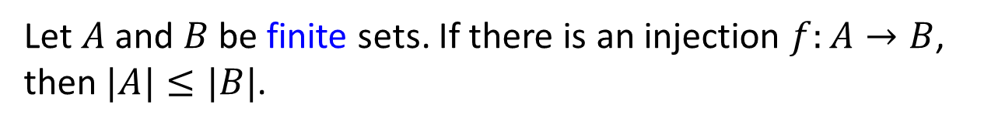


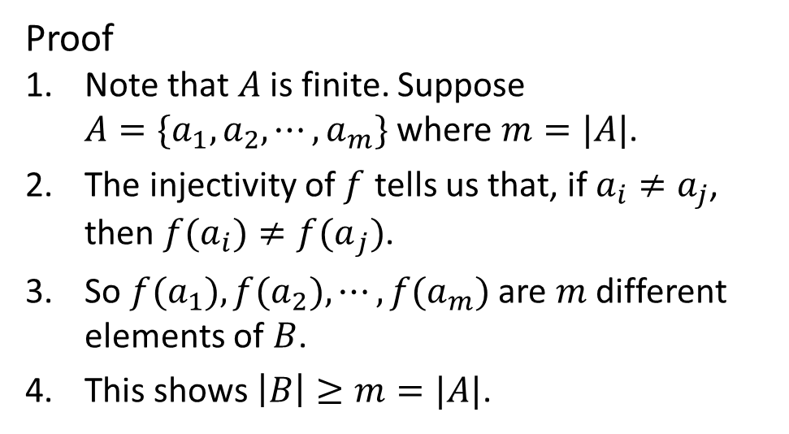
Cardinality Countably Infinite Countability via Sequences Larger Infinities
Pigeonhole Principle
Pigeonhole Principle
Let $A$ and $B$ be finite sets. If there is an injection $f:A→B$, then $|A|≤|B|$.
Proof
1. Note that $A$ is finite. Suppose $A=\{a_{1},a_{2},⋯,a_{m}\}$ where $m=|A|$.
2. The injectivity of $f$ tells us that, if $a_{i}≠a_{j}$, then ${f(a}_{i})≠{f(a}_{j})$.
3. So ${f(a}_{1}),f(a_{2}),⋯,f(a_{m})$ are $m$ different elements of $B$.
4. This shows $\left|B\right|≥m=|A|$.
$$A$$
$$B$$

Slide 8
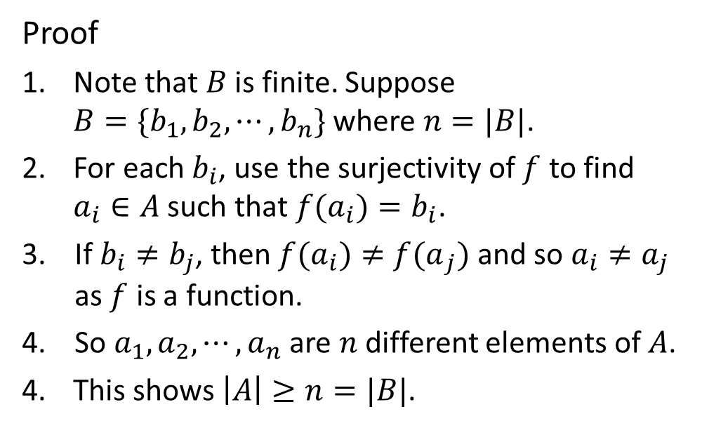


Cardinality Countably Infinite Countability via Sequences Larger Infinities
Pigeonhole Principle
Dual Pigeonhole Principle
Let $A$ and $B$ be finite sets. If there is a surjection $f:A→B$, then $|A|≥|B|$.
Proof
1. Note that $B$ is finite. Suppose $B=\{b_{1},b_{2},⋯,b_{n}\}$ where $n=|B|$.
2. For each $b_{i}$, use the surjectivity of $f$ to find $a_{i}∈A$ such that ${f(a}_{i})=b_{i}$.
If $b_{i}≠b_{j}$, then ${f(a}_{i})≠{f(a}_{j})$ and so $a_{i}≠a_{j}$ as $f$ is a function.
So $a_{1},a_{2},⋯,a_{n}$ are $n$ different elements of $A$.
4. This shows $\left|A\right|≥n=|B|$.
$$A$$
$$B$$

Slide 9
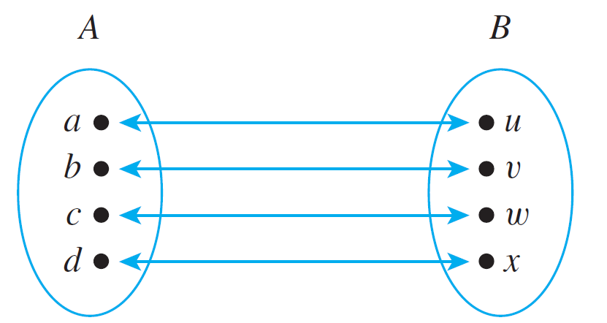

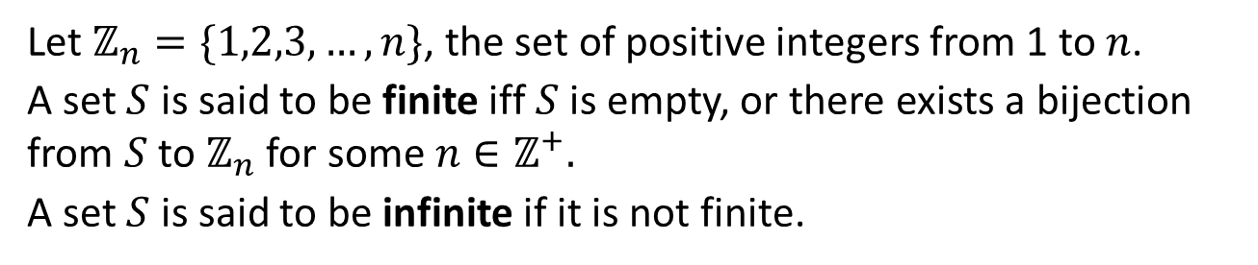
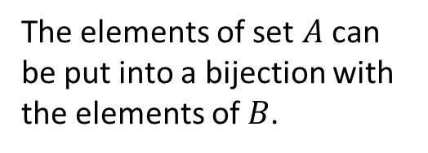
Cardinality Countably Infinite Countability via Sequences Larger Infinities
Cardinality
9.1.2 Cardinality
Definitions: Finite set and Infinite set
Let $ℤ_{n}=\{1,2,3,…,n\}$, the set of positive integers from 1 to $n$.
A set $S$ is said to be finite iff $S$ is empty, or there exists a bijection from $S$ to $ℤ_{n}$ for some $n∈ℤ^{+}.$
A set $S$ is said to be infinite if it is not finite.
We say that two finite sets whose elements can be paired by a bijection have the same size$.$
The elements of set $A$ can be put into a bijection with the elements of $B$.

Slide 10
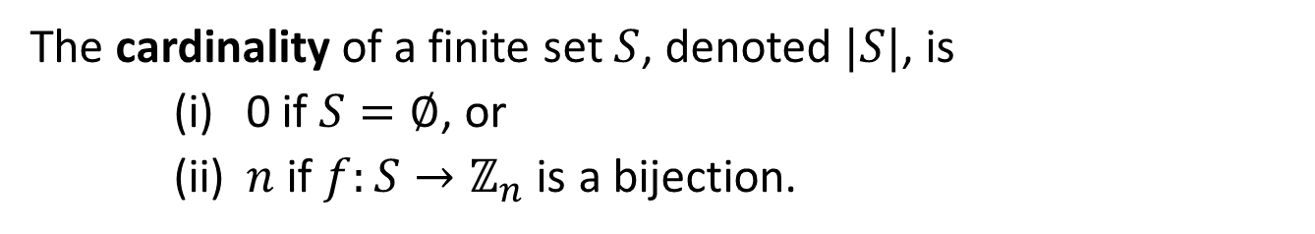
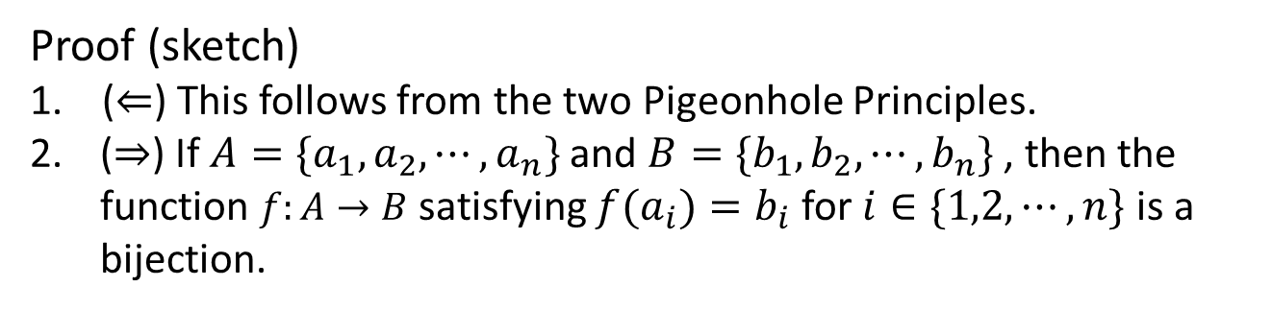
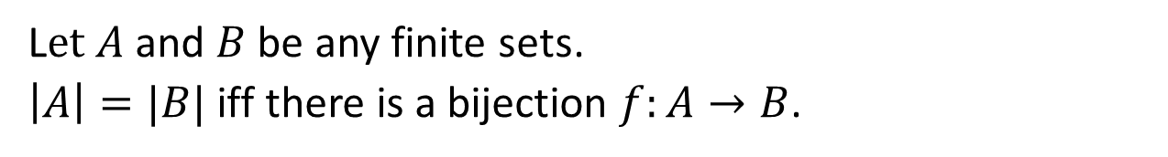
Cardinality Countably Infinite Countability via Sequences Larger Infinities
Cardinality
Definition: Cardinality
The cardinality of a finite set $S$, denoted $|S|$, is
(i) 0 if $S=∅$, or
(ii) $n$ if $f:S→ℤ_{n}$ is a bijection.
Theorem: Equality of Cardinality of Finite Sets
L$et A$ and $B$ be any finite sets.
$\left|A\right|=|B|$ iff there is a bijection $f:A→B$.
Proof (sketch)
($⇐$) This follows from the two Pigeonhole Principles.
2. ($⇒$) If $A=\{a_{1},a_{2},⋯,a_{n}\}$ and $B=\{b_{1},b_{2},⋯,b_{n}\}$ , then the function $f:A→B$ satisfying ${f(a}_{i})=b_{i}$ for $i∈\{1,2,⋯,n\}$ is a bijection.

Slide 11
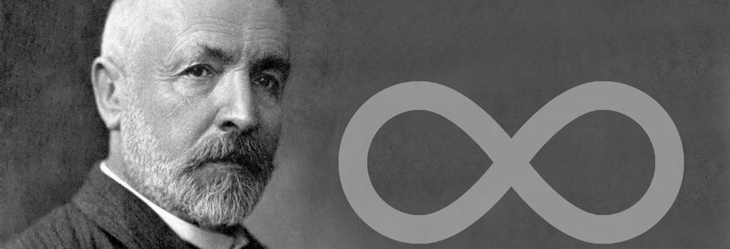

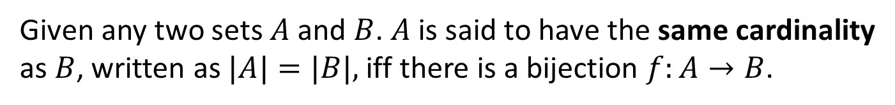
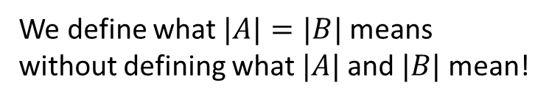
Cardinality Countably Infinite Countability via Sequences Larger Infinities
Cardinality
What about infinite sets?
Georg Cantor
(1845 – 1918)
https://en.wikipedia.org/wiki/Georg_Cantor
Definition: Same Cardinality (Cantor)
Given any two sets $A$ and $B$. $A$ is said to have the same cardinality as $B$, written as $|A|=|B|,$iff there is a bijection $f:A→B$.
We define what $|A|=|B|$means without defining what $|A|$and $|B|$mean!

Slide 12




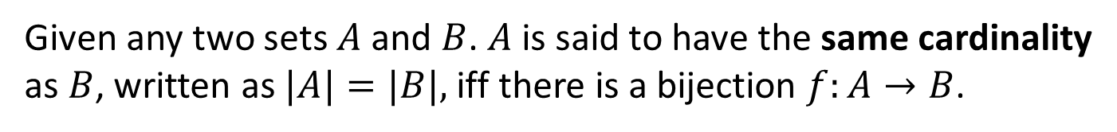











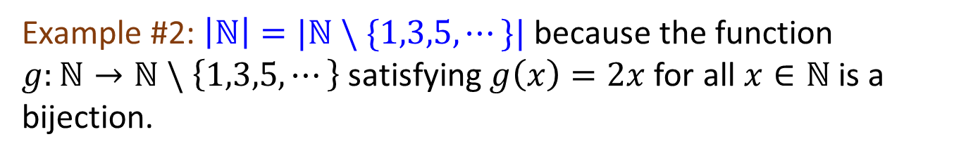





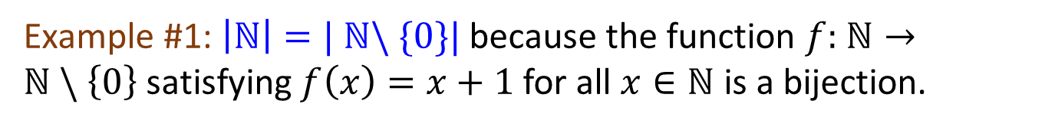





Cardinality Countably Infinite Countability via Sequences Larger Infinities
Cardinality
Definition: Same Cardinality (Cantor)
Given any two sets $A$ and $B$. $A$ is said to have the same cardinality as $B$, written as $|A|=|B|,$iff there is a bijection $f:A→B$.
Example #1: $\left|ℕ\right|=|$ $ℕ\backslash \{0\}|$because the function $f:$ $ℕ→ℕ \backslash \left\{0\right\}$satisfying $f\left(x\right)=x+1$ for all $x∈ℕ$ is a bijection.
$$0$$
$$1$$
$$2$$
$$3$$
$$4$$
$$⋯$$
$$0$$
$$1$$
$$2$$
$$3$$
$$⋯$$
$$f$$
$$g$$
$$1$$
$$2$$
$$3$$
$$4$$
$$5$$
$$⋯$$
$$0$$
$$2$$
$$4$$
$$6$$
$$⋯$$
Example #2: $\left|ℕ\right|=|ℕ \backslash \{1,3,5,⋯\}|$because the function $g:ℕ→ℕ \backslash \left\{1,3,5,⋯\right\}$ satisfying $g\left(x\right)=2x$ for all $x∈ℕ$ is a bijection.
Recall we define $ℕ=\left\{0,1,2,3,⋯\right\}.$

Slide 13
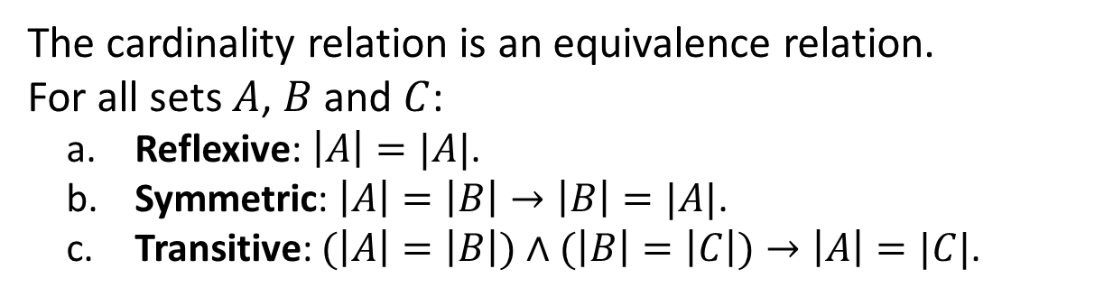
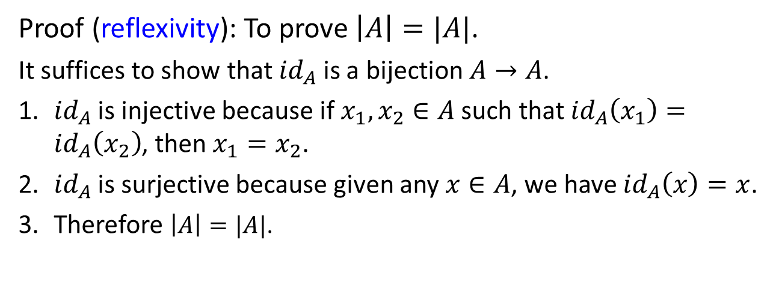
Cardinality Countably Infinite Countability via Sequences Larger Infinities
Cardinality
Theorem 7.4.1 Properties of Cardinality
The cardinality relation is an equivalence relation.
For all sets $A$, $B$ and $C$:
a. Reflexive: $\left|A\right|=|A|$.
b. Symmetric: $\left|A\right|=\left|B\right|→\left|B\right|=|A|$.
c. Transitive: $(\left|A\right|=\left|B\right|)∧(\left|B\right|=\left|C\right|)→\left|A\right|=|C|$.
Proof (reflexivity): To prove $\left|A\right|=|A|$.
It suffices to show that ${id}_{A}$ is a bijection $A→A$.
1. ${id}_{A}$ is injective because if $x_{1},x_{2}∈A$ such that ${id}_{A}\left(x_{1}\right)={id}_{A}\left(x_{2}\right)$, then $x_{1}=x_{2}$.
2. ${id}_{A}$ is surjective because given any $x∈A$, we have ${id}_{A}\left(x\right)=x$.
3. Therefore $\left|A\right|=|A|$.

Slide 14
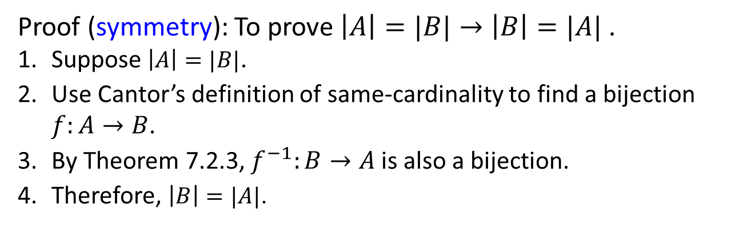
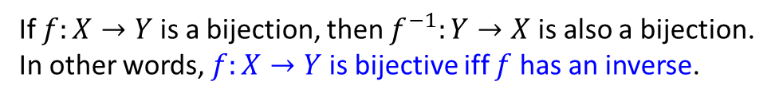
Cardinality Countably Infinite Countability via Sequences Larger Infinities
Cardinality
Theorem 7.4.1 Properties of Cardinality
The cardinality relation is an equivalence relation.
For all sets $A$, $B$ and $C$:
a. Reflexive: $\left|A\right|=|A|$.
b. Symmetric: $\left|A\right|=\left|B\right|→\left|B\right|=|A|$.
c. Transitive: $(\left|A\right|=\left|B\right|)∧(\left|B\right|=\left|C\right|)→\left|A\right|=|C|$.
Proof (symmetry): To prove $\left|A\right|=|B|→\left|B\right|=|A|$ .
1. Suppose $\left|A\right|=|B|$.
2. Use Cantor’s definition of same-cardinality to find a bijection $f:A→B$.
3. By Theorem 7.2.3, $f^{−1}:B→A$ is also a bijection.
4. Therefore, $\left|B\right|=|A|$.
Theorem 7.2.3
If $f:X→Y$ is a bijection, then $f^{−1}:Y→X$ is also a bijection.
In other words, $f:X→Y$ is bijective iff $f$ has an inverse.

Slide 15
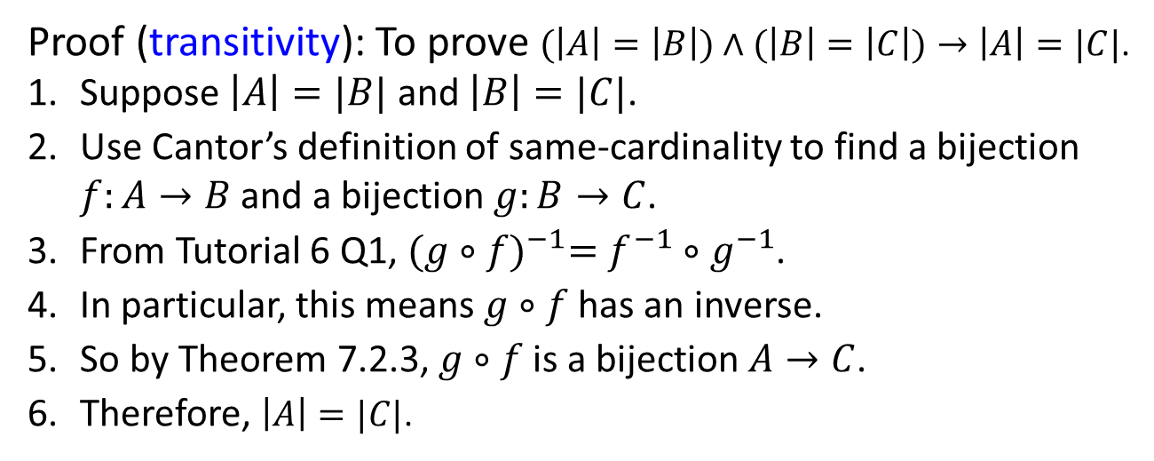
Cardinality Countably Infinite Countability via Sequences Larger Infinities
Cardinality
Theorem 7.4.1 Properties of Cardinality
The cardinality relation is an equivalence relation.
For all sets $A$, $B$ and $C$:
a. Reflexive: $\left|A\right|=|A|$.
b. Symmetric: $\left|A\right|=\left|B\right|→\left|B\right|=|A|$.
c. Transitive: $(\left|A\right|=\left|B\right|)∧(\left|B\right|=\left|C\right|)→\left|A\right|=|C|$.
Proof (transitivity): To prove $(\left|A\right|=\left|B\right|)∧(\left|B\right|=\left|C\right|)→\left|A\right|=|C|$.
1. Suppose $\left|A\right|=|B|$ and $\left|B\right|=|C|$.
2. Use Cantor’s definition of same-cardinality to find a bijection $f:A→B$ and a bijection $g:B→C$.
3. From Tutorial 6 Q1, ${(g∘f)}^{−1}=f^{−1}∘g^{−1}$.
4. In particular, this means $g∘f$ has an inverse.
5. So by Theorem 7.2.3, $g∘f$ is a bijection $A→C$.
6. Therefore, $\left|A\right|=|C|$.

Slide 16
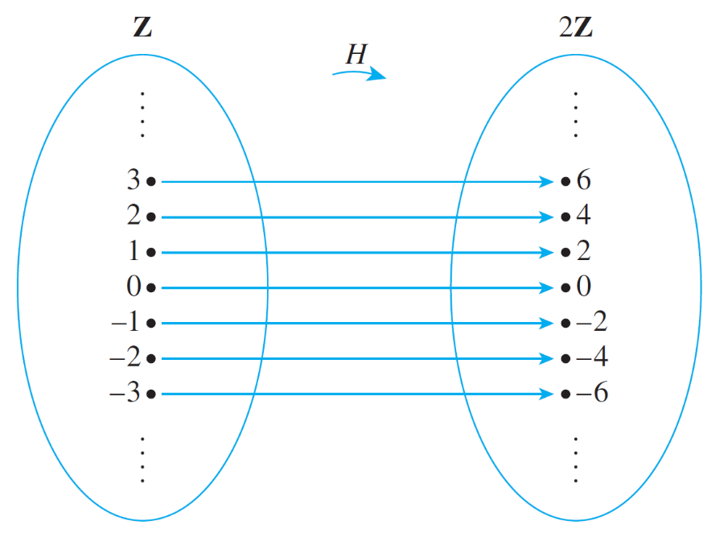
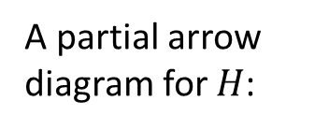
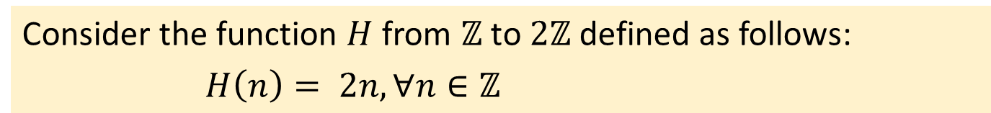
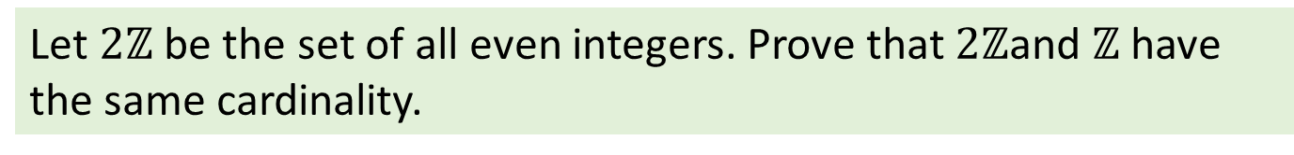
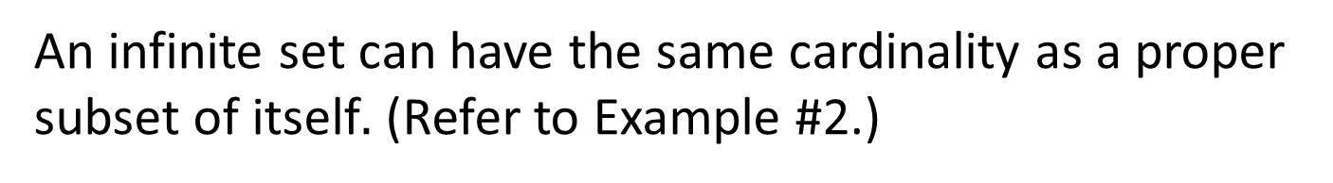
Cardinality Countably Infinite Countability via Sequences Larger Infinities
Cardinality: $\left|2ℤ\right|=|ℤ|$
9.1.3 $\left|2ℤ\right|=|ℤ|$
An infinite set can have the same cardinality as a proper subset of itself$.$ (Refer to Example #2.)
Let $2ℤ$ be the set of all even integers. Prove that $2ℤ$and $ℤ$ have the same cardinality.
Consider the function $H$ from $ℤ$ to $2ℤ$ defined as follows:
$H\left(n\right)= 2n, ∀n∈ℤ$
A partial arrow diagram for $H$:

Slide 17
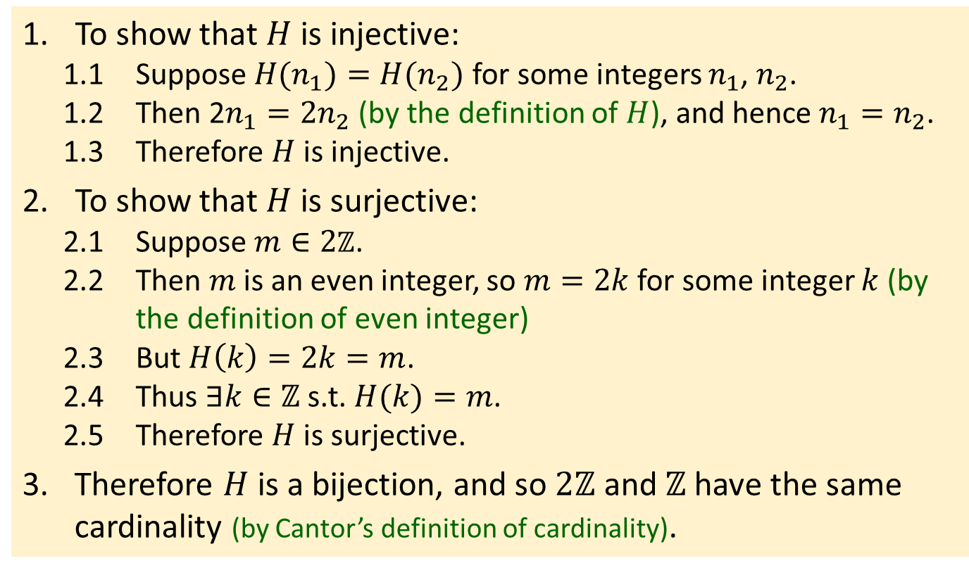
Cardinality Countably Infinite Countability via Sequences Larger Infinities
Cardinality: $\left|2ℤ\right|=|ℤ|$
To show that $H$ is injective:
1.1 Suppose $H(n_{1})=H(n_{2})$ for some integers $n_{1}$, $n_{2}$.
1.2 Then 2$n_{1}=2n_{2}$ (by the definition of $H$), and hence $n_{1}=n_{2}$.
1.3 Therefore $H$ is injective.
2. To show that $H$ is surjective:
2.1 Suppose $m∈2ℤ$.
2.2 Then $m$ is an even integer, so $m=2k$ for some integer $k$ (by the definition of even integer)
2.3 But $H\left(k\right)=2k=m$.
2.4 Thus $∃k∈ℤ$ s.t. $H(k)=m$.
2.5 Therefore $H$ is surjective.
3. Therefore $H$ is a bijection, and so $2ℤ$ and $ℤ$ have the same cardinality (by Cantor’s definition of cardinality).

Slide 18


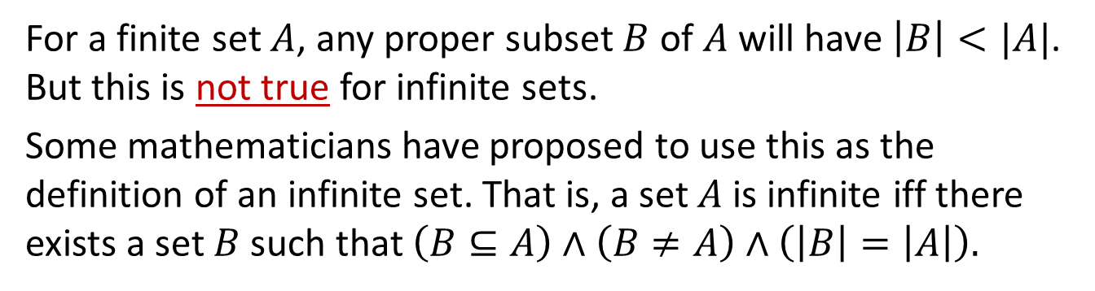
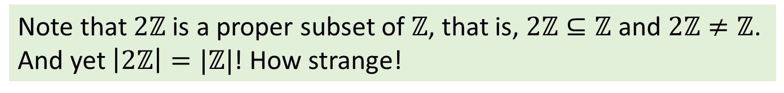
Cardinality Countably Infinite Countability via Sequences Larger Infinities
Cardinality: $\left|2ℤ\right|=|ℤ|$
Note that $2ℤ$ is a proper subset of $ℤ$, that is, $2ℤ⊆ℤ$ and $2ℤ≠ℤ$. And yet $\left|2ℤ\right|=|ℤ|$! How strange!
For a finite set $A$, any proper subset $B$ of $A$ will have $\left|B\right|<|A|$. But this is not true for infinite sets.
Some mathematicians have proposed to use this as the definition of an infinite set. That is, a set $A$ is infinite iff there exists a set $B$ such that $\left(B⊆A\right)∧\left(B≠A\right)∧\left(\left|B\right|=\left|A\right|\right).$

Slide 19
Cardinality Countably Infinite Countability via Sequences Larger Infinities
9.2 Countably Infinite

Slide 20
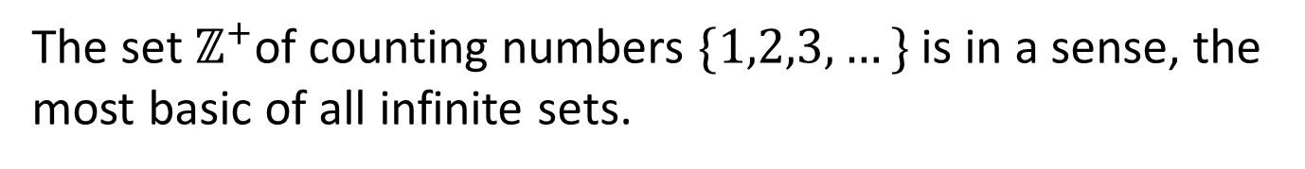
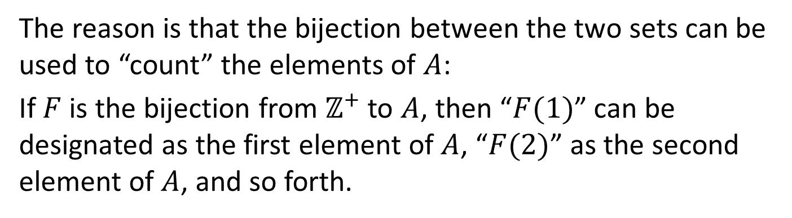
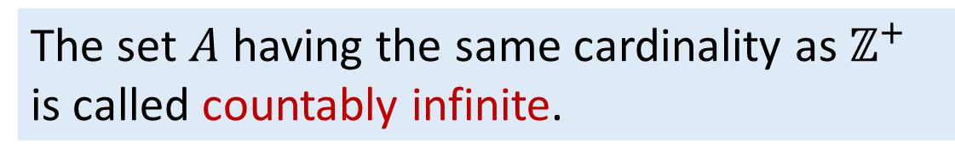
Cardinality Countably Infinite Countability via Sequences Larger Infinities
Countably Infinite: Countable Sets
9.2.1 Countable Sets
The set $ℤ^{+}$of counting numbers $\{1,2,3,…\}$ is in a sense, the most basic of all infinite sets.
The set $A$ having the same cardinality as $ℤ^{+}$ is called countably infinite.
The reason is that the bijection between the two sets can be used to “count” the elements of $A$:
If $F$ is the bijection from $ℤ^{+}$ to $A$, then “$F(1)$” can be designated as the first element of $A$, “$F(2)$” as the second element of $A$, and so forth.
Note: We may use $ℕ$ or $ℤ_{≥0}$ instead of $ℤ^{+}$ in the definition.

Slide 21
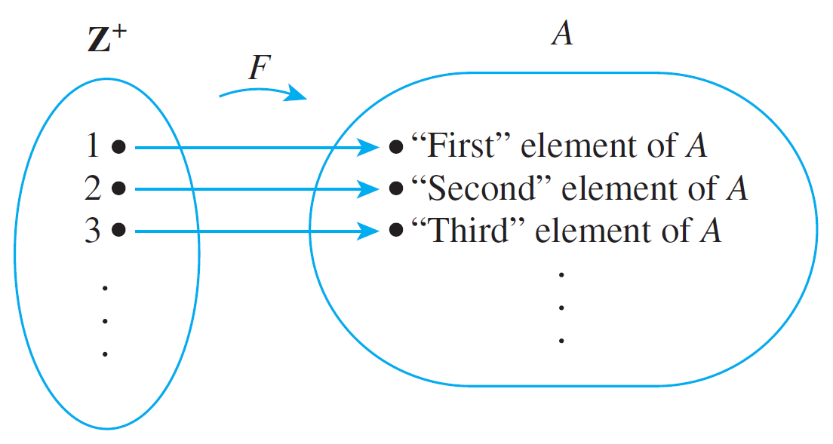
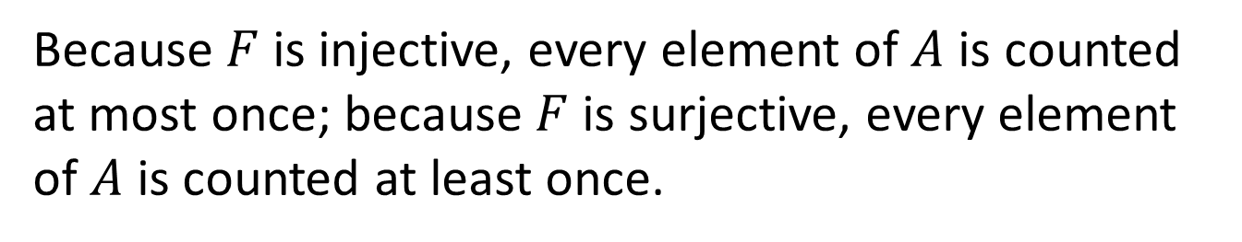
Cardinality Countably Infinite Countability via Sequences Larger Infinities
Countably Infinite: Countable Sets
“Counting” a Countably Infinite Set
Figure 7.4.1
Because $F$ is injective, every element of $A$ is counted at most once; because $F$ is surjective, every element of $A$ is counted at least once.

Slide 22
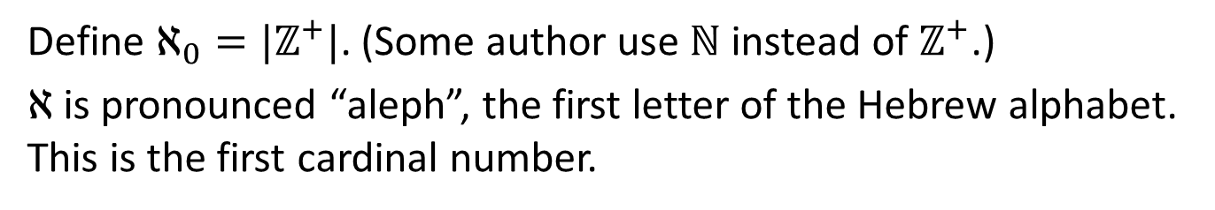
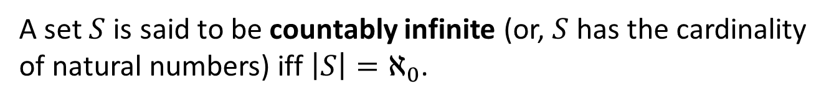
Cardinality Countably Infinite Countability via Sequences Larger Infinities
Countably Infinity: Countable Sets
Definition: Cardinal numbers
Define $ℵ_{0}=|ℤ^{+}|$. (Some author use $ℕ$ instead of $ℤ^{+}$.)
$ℵ$is pronounced “aleph”, the first letter of the Hebrew alphabet. This is the first cardinal number.
Definition: Countably infinite
A set $S$ is said to be countably infinite (or, $S$ has the cardinality of natural numbers) iff $\left|S\right|=ℵ_{0}$.
Definitions: Countable set and Uncountable set
A set is said to be countable iff it is finite or countably infinite.
A set is said to be uncountable if it is not countable

Slide 23

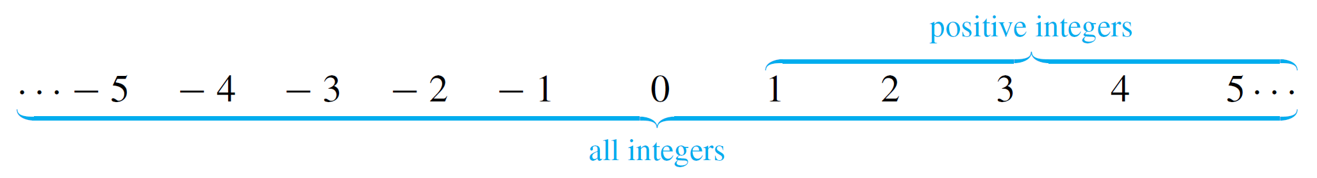
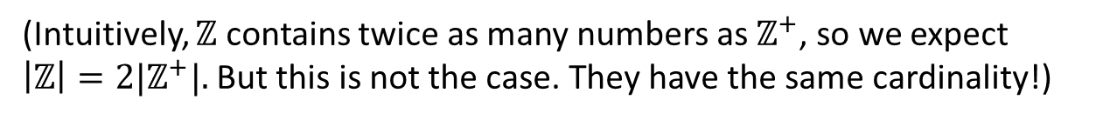
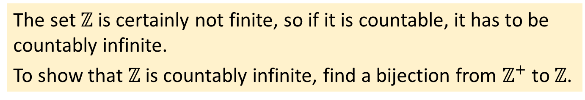
Cardinality Countably Infinite Countability via Sequences Larger Infinities
Countably Infinite: $ℤ$ is countable
9.2.2 $ℤ$ is countable
Example #3: Show that $ℤ$ is countable.
(Intuitively, $ℤ$ contains twice as many numbers as $ℤ^{+}$, so we expect ${\left|ℤ\right|=2|ℤ}^{+}|.$ But this is not the case. They have the same cardinality!)
The set $ℤ$ is certainly not finite, so if it is countable, it has to be countably infinite.
To show that $ℤ$ is countably infinite, find a bijection from $ℤ^{+}$ to $ℤ$.
The appears to contradict common sense, as there appear to be more than twice as many integers as there are positive integers:

Slide 24
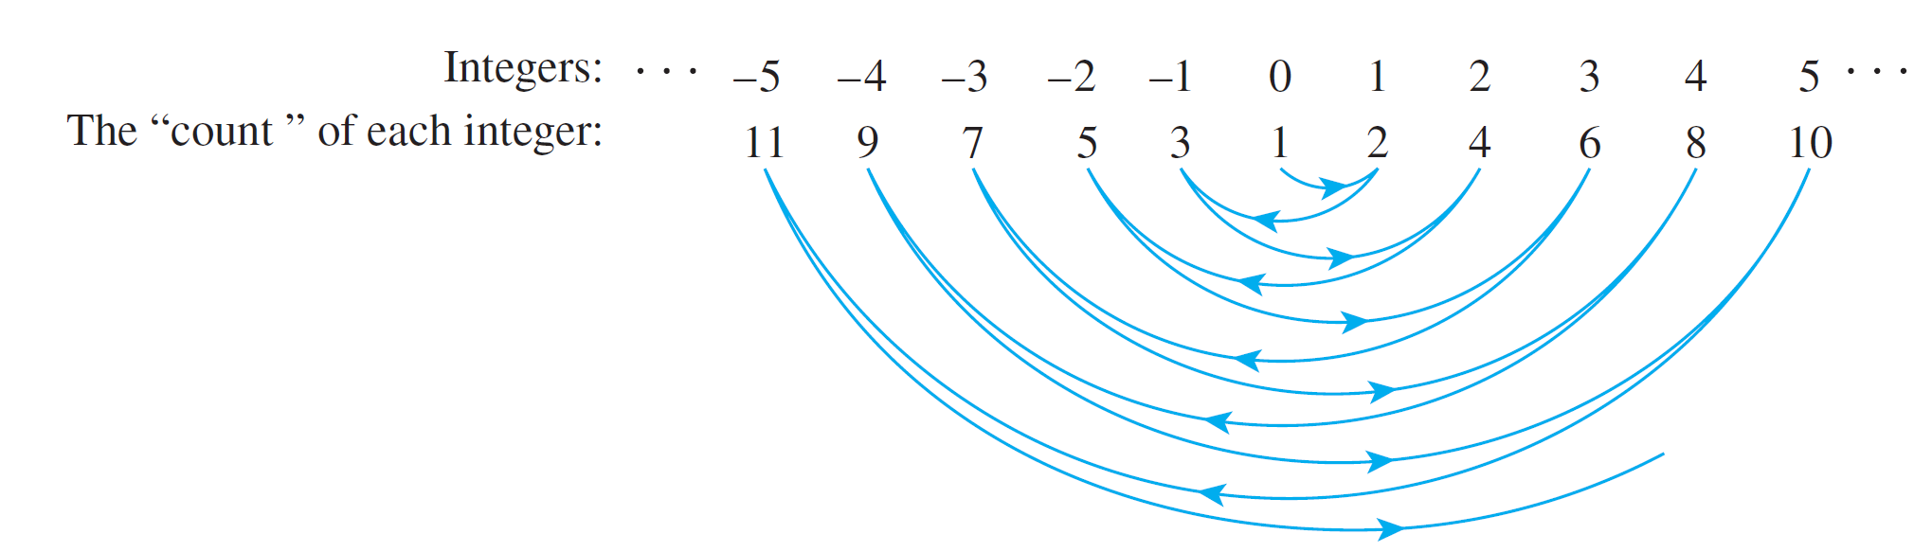
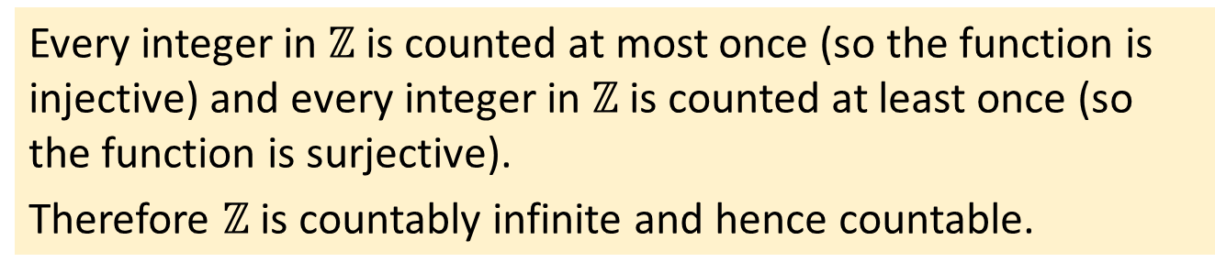
Cardinality Countably Infinite Countability via Sequences Larger Infinities
Countably Infinite: $ℤ$ is countable
The trick is to start in the middle and work outward systematically. Let the first integer be 0, the second 1, the third -1, the fourth 2, the fifth -2, and so forth:
“Counting” the Set of All Integers
Figure 7.4.2
Every integer in $ℤ$ is counted at most once (so the function is injective) and every integer in $ℤ$ is counted at least once (so the function is surjective).
Therefore $ℤ$ is countably infinite and hence countable.

Slide 25
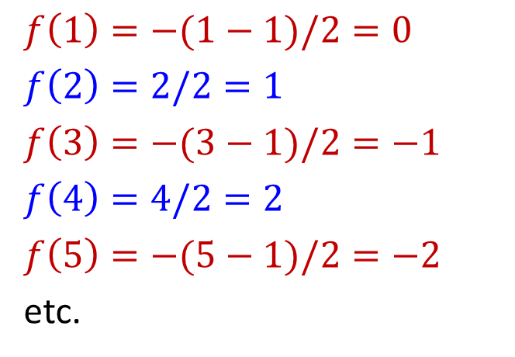
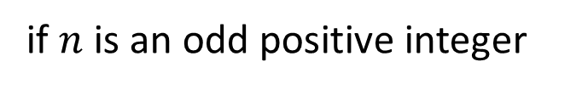
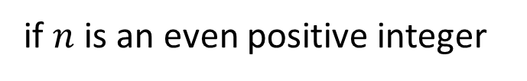
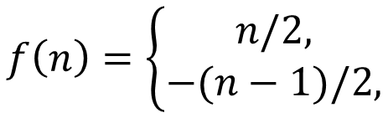
Cardinality Countably Infinite Countability via Sequences Larger Infinities
Countably Infinite: $ℤ$ is countable
The bijection as described earlier can be formulated as follows:
$$f\left(n\right)=\left\{\begin{aligned}n/2, \\ −(n−1)/2,\end{aligned}\right.$$
if $n$ is an even positive integer
if $n$ is an odd positive integer
$$f\left(1\right)=−(1−1)/2=0$$
$$f\left(2\right)=2/2=1$$
$$f\left(3\right)=−(3−1)/2=−1$$
$$f\left(4\right)=4/2=2$$
$$f\left(5\right)=−(5−1)/2=−2$$
etc.

Slide 26
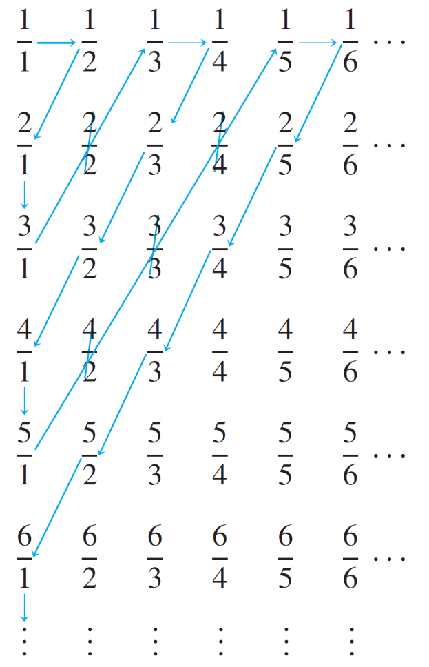



Cardinality Countably Infinite Countability via Sequences Larger Infinities
Countably Infinite: $ℚ^{+}$ is countable
9.2.3 $ℚ^{+}$ is countable
Example #4: Show that $ℚ^{+}$ (the set of all positive rational numbers) is countable.
Display the elements of $ℚ^{+}$ in a grid as shown:
✗
✗
Define a function F from $ℤ^{+}$ to $ℚ^{+}$ by starting to count at $\frac{1}{1}$ and following the arrows as indicated, skipping over any number that has already been counted.
✗
✗
Figure 7.4.3

Slide 27





Cardinality Countably Infinite Countability via Sequences Larger Infinities
Larger Infinities
So, set $F\left(1\right)=\frac{1}{1}, F\left(2\right)=\frac{1}{2},F\left(3\right)=\frac{2}{1},F\left(4\right)=\frac{3}{1}.$
Then skip $\frac{2}{2}$ since $\frac{2}{2}=\frac{1}{1}$ which was counted.
Followed by $F\left(5\right)=\frac{1}{3},F\left(6\right)=\frac{1}{4},F\left(7\right)=\frac{2}{3},$ etc.
✗
✗
✗
✗
Note that every positive rational number appears somewhere in the grid, and the counting procedure is set up so that every point in the grid is reached eventually. Thus $F$ is surjective.
Skipping numbers that have already been counted ensures that no number is counted twice. Thus $F$ is injective.
S$o F$ is a bijection from $ℤ^{+}$ to $ℚ^{+}$. Therefore $ℚ^{+}$ is countably infinite and hence countable.

Slide 28
Cardinality Countably Infinite Countability via Sequences Larger Infinities
Countably Infinite: $ℤ^{+}×ℤ^{+}$ is countable
9.2.4 $ℤ^{+}×ℤ^{+}$is countable
The Infinite Hotel:
https://www.youtube.com/watch?v=Uj3_KqkI9Zo

Slide 29



Cardinality Countably Infinite Countability via Sequences Larger Infinities
Countably Infinite: $ℤ^{+}×ℤ^{+}$ is countable
Theorem: $ℤ^{+}×ℤ^{+}$ is countable.
What if an infinite number of buses, each carrying an infinite number of guests, arrive at the Infinite Hotel? Is there room for all of them?
Display the elements of$ℤ^{+}×ℤ^{+}$ in a grid as shown:
Guests
The ordered pair $(x,y)$ denotes bus $x$ and guest $y$.
We then count the ordered paired in the following order according to this function $f:ℤ^{+}×ℤ^{+}→ℤ^{+}$ by:
Bus
$$f\left(x,y\right)=\frac{(x+y−2)(x+y−1)}{2}+x$$

Slide 30



Cardinality Countably Infinite Countability via Sequences Larger Infinities
Countably Infinite: Theorems
9.2.5 Theorems
Theorem (Cartesian Product)
If sets $A$ and $B$ are both countably infinite, then so is $A×B$.
(Proof omitted. Similar to diagonal counting method in example #4.)
Corollary (General Cartesian Product)
Given $n≥2$ countably infinite sets $A_{1},A_{2},⋯,A_{n}$, the Cartesian product $A_{1}×A_{2}×⋯×A_{n}$ is also countably infinite.
(Proof omitted. Proof by induction on $n$.)
Theorem (Unions)
The union of countably many countable sets is countable. That is, if $A_{1},A_{2},⋯$ are all countable sets, then so is
$$\bigcup_{i=1}^{∞}{A_{i}}$$
(Proof omitted. Similar to diagonal counting method in example #4.)

Slide 31
Cardinality Countably Infinite Countability via Sequences Larger Infinities
9.3 Countability via Sequences

Slide 32















Cardinality Countably Infinite Countability via Sequences Larger Infinities
Definition: A set is said to be countable iff it is finite or countably infinite, that is, it has the same cardinality as $ℤ_{≥0}$.
Note: In this section, we use $ℤ_{≥0}$ instead of $ℤ^{+}$ as we are relating to sequences.
Proposition 9.1
An infinite set $B$ is countable if and only if there is a sequence $b_{0},b_{1},b_{2},⋯∈B$ in which every element of $B$ appears exactly once.
$$ℤ_{≥0}$$
$$B$$
Justification:
$$⋮$$
$$⋮$$
$$2$$
$$b_{2}$$
$$1$$
$$b_{1}$$
function $f:ℤ_{≥0}→B$
$$f\left(0\right),f\left(1\right),f\left(2\right),⋯$$
(surjectivity) $∀b∈B ∃i∈ℤ_{≥0} f\left(i\right)=b$
(injectivity) $∀i,j$ $∈ℤ_{≥0} \left(f\left(i\right)=f\left(j\right)⇒i=j\right)$
sequence of elements of $B$
$$b_{0},b_{1},b_{2},⋯$$
Every $b∈B$ appears at least once.
Every $b∈B$ appears at most once.
$$0$$
$$b_{0}$$
Definition: A sequence $a_{0},a_{1},a_{2},⋯$ can be represented by a function $a$ whose domain is $ℤ_{≥0}$ that satisfies $a(n)=a_{n}$ for every $n∈ℤ_{≥0}$.

Slide 33



Cardinality Countably Infinite Countability via Sequences Larger Infinities
Proposition 9.1
An infinite set $B$ is countable if and only if there is a sequence $b_{0},b_{1},b_{2},⋯∈B$ in which every element of $B$ appears exactly once.
Lemma 9.2: Countability via Sequence
An infinite set $B$ is countable if and only if there is a sequence $b_{0},b_{1},b_{2},⋯$ in which every element of $B$ appears.
Proof:
1. (“only if”) This follows directly from Proposition 9.1.
2. (“if”)
2.1. Let $b_{0},b_{1},b_{2},⋯$ be a sequence in which every element of $B$ appears.
2.2. Remove those terms in the sequence that are not in $B$.
2.3. If an element of $B$ appears more than once, then remove all but the first appearance.
2.4. The result is a sequence in which every element of $B$ appears exactly once.
2.5. So $B$ is countable.

Slide 34

Cardinality Countably Infinite Countability via Sequences Larger Infinities
Theorem: $ℤ^{+}×ℤ^{+}$ is countable. (Revisit)
We will provide a proof sketch using sequence.
Proof sketch:
The figure below describes a sequence: (1,1),(1,2),(2,1),(1,3),(2,2),…
in which every element of $ℤ^{+}×ℤ^{+}$ appears.
So $ℤ^{+}×ℤ^{+}$is countable by Lemma 9.2.
Guests
Bus

Slide 35

Cardinality Countably Infinite Countability via Sequences Larger Infinities
9.4 Larger Infinities

Slide 36


Cardinality Countably Infinite Countability via Sequences Larger Infinities
Larger Infinities
In 1874 the German mathematician Georg Cantor achieved success in the search for a larger infinity by showing that the set of all real numbers is uncountable. His method of proof was somewhat complicated, however.
Georg Cantor, the man who discovered different infinities.
The uncountability of the set of all real numbers between 0 and 1 using a simpler technique introduced by Cantor in 1891 is known as the Cantor’s diagonalization process.
Over the intervening years, this technique and variations on it have been used to establish a number of important results in logic and the theory of computation.

Slide 37


Cardinality Countably Infinite Countability via Sequences Larger Infinities
Larger Infinities: Cantor’s Diagonalization Argument
9.4.1 Cantor’s Diagonalization Argument
Theorem 7.4.2 (Cantor)
The set of real numbers between 0 and 1,
$\left(0,1\right)=\left\{x∈ℝ \right| 0<x<1\}$
is uncountable.
To prove that a set is uncountable means proving that there is no possibility of a bijection from that set to $ℤ^{+}.$
The way to prove is by contradiction. Georg Cantor, who gave us set theory, also gave an ingenious proof for the above theorem, came to be known as the Cantor’s Diagonalization Argument.

Slide 38

Cardinality Countably Infinite Countability via Sequences Larger Infinities
Larger Infinities: Cantor’s Diagonalization Argument
Sketch of proof (proof by contradiction):
1. Suppose $(0,1)$ is countable.
2. Since it is not finite, it is countably infinite.
3. We list the elements $x_{i}$ of $(0,1)$in a sequence as follows:
$x_{1}=0.$ $a_{11}$ $a_{12}a_{13}⋯a_{1n}$ $⋯$
$x_{2}=0.$ $a_{21}$ $a_{22}a_{23}⋯a_{2n}$ $⋯$
$x_{3}=0.$ $a_{31}$ $a_{32}a_{33}⋯a_{3n}$ $⋯$
$⋮$
$x_{n}=0.$ $a_{n1}$ $a_{n2}a_{n3}⋯a_{nn}$ $⋯$
$⋮$
where each $a_{ij}∈\{0,1,⋯,9\}$ is a digit.*
* Note that some numbers have two representations, eg: 0.49999… = 0.50000… We agree to use only the latter representation.

Slide 39





Cardinality Countably Infinite Countability via Sequences Larger Infinities
Larger Infinities: Cantor’s Diagonalization Argument
4. Now, construct a number $d=0.$ $d_{1}$ $d_{2}d_{3}⋯d_{n}$ $⋯$ s.t.
$d_{n}=\left\{\begin{aligned}1, if a_{nn}≠1; \\ 2, if a_{nn}=1.\end{aligned}\right.$
$x_{1}=0.$ $a_{11}$ $a_{12}a_{13}⋯a_{1n}$ $⋯$
$x_{2}=0.$ $a_{21}$ $a_{22}a_{23}⋯a_{2n}$ $⋯$
$x_{3}=0.$ $a_{31}$ $a_{32}a_{33}⋯a_{3n}$ $⋯$
$⋮$
$x_{n}=0.$ $a_{n1}$ $a_{n2}a_{n3}⋯a_{nn}$ $⋯$
5. Note that $∀n∈ℤ^{+},d_{n}≠a_{nn}$. Thus, $d≠x_{n},∀n∈ℤ^{+}$.
6. But clearly, $d∈(0,1)$, hence a contradiction. Therefore $(0,1)$is uncountable.
Illustration:
$0.20148802…$ $d_{1}$ is 1 because $a_{11}=2$
$0.11666021…$ $d_{2}$ is 2 because $a_{22}=1$
$0.03853320…$ $d_{3}$ is 1 because $a_{33}=8$
$0.96776809…$ $d_{4}$ is 1 because $a_{44}=7$
$0.00031002…$ $d_{5}$ is 2 because $a_{55}=1$
Hence $d=0.12112…$, which is not in the list. So, the list is incomplete. This is true regardless of how the elements in (0,1) are listed.

Slide 40

Cardinality Countably Infinite Countability via Sequences Larger Infinities
Larger Infinities: Any subset of any countable set is countable
Theorem 7.4.3
Any subset of any countable set is countable.
Proof:
Let $A$ be any countable set and $B$ be any subset of $A$.
If $A$ is finite then $B$ must be finite and hence countable – done.
Suppose $A$ is countably infinite. If $B$ is finite, then $B$ is countable – done.
4. Suppose $B$ is infinite.
4.1 Since $A$ is countable, there is a bijection $f:ℤ^{+}→A$.
4.2 Let $M=f^{−1}(B)$ (note that $f^{−1}$ is a bijection), and define a function $g:ℤ^{+}→B$ inductively as follows:
S1. L$et g\left(1\right)=f\left(i_{1}\right)$, where $i_{1}$ is the minimum element in $M$.
S2. If $g\left(1\right),g\left(2\right),⋯,g\left(k−1\right)$ have been defined, …

Slide 41





























Cardinality Countably Infinite Countability via Sequences Larger Infinities
Larger Infinities: Any subset of any countable set is countable
4. Suppose $B$ is infinite.
4.1 Since $A$ is countable, there is a bijection $f:ℤ^{+}→A$.
4.2 Let $M=f^{−1}(B)$ (note that $f^{−1}$ is a bijection), and define a function $g:ℤ^{+}→B$ inductively as follows :
S1. L$et g\left(1\right)=f\left(i_{1}\right)$, where $i_{1}$ is the minimum element in $M$.
S2. If $g\left(1\right),g\left(2\right),⋯,g\left(k−1\right)$ have been defined, let
$g\left(k\right)=f(i_{k})$, where $i_{k}=min⁡\{m:m>i_{k−1}, m∈M\}$.
4.3 $g$ is a bijection (why?), hence $B$ is countable.
$$ℤ^{+}$$
$$A$$
$$ℤ^{+}$$
$$f^{−1}$$
$$A$$
$$f$$
1
$$a_{1}$$
1
$$a_{1}$$
2
$$a_{2}$$
$$a_{3}$$
2
$$a_{2}$$
$$a_{3}$$
4
4
9
6
$$a_{4}$$
:
9
6
$$a_{4}$$
:
:
$$a_{8}$$
$$a_{5}$$
:
$$a_{8}$$
$$a_{5}$$
$$ℤ^{+}$$
$$g$$
$$B$$
7
7
$$B$$
3
$$a_{6}$$
$$M$$
3
$$a_{6}$$
1
$$a_{6}$$
8
$$a_{7}$$
8
$$a_{7}$$
3
$$a_{7}$$
5
$$a_{9}$$
5
$$a_{9}$$
2
$$a_{9}$$
:
:
:
:
:
:

Slide 42

Cardinality Countably Infinite Countability via Sequences Larger Infinities
Larger Infinities: Any subset of any countable set is countable
Theorem 7.4.3
Any subset of any countable set is countable.
Corollary 7.4.4 (Contrapositive of Theorem 7.4.3)
Any set with an uncountable subset is uncountable.
Corollary 7.4.4 implies that $ℝ$ is uncountable since $(0,1)⊆ℝ$ and $(0,1)$ is uncountable.

Slide 43

Cardinality Countably Infinite Countability via Sequences Larger Infinities
Larger Infinities: Every infinite set has a countably infinite subset
Proposition 9.3
Every infinite set has a countably infinite subset.
Proof:
1. Let $B$ be an infinite set.
2. Keep choosing elements $b_{0},b_{1},b_{2},⋯$ from $B$.
3. When we choose $b_{n}$, where $n∈ℤ_{≥0}$, we can always make sure $b_{n}≠b_{i}$ for any $i<n,$ because otherwise $B$ is equal to the finite set ${\{b}_{0},b_{1},b_{2},⋯,$ $b_{n−1}\}$ which is a contradiction.
4. The result is a countably infinite set ${\{b}_{0},b_{1},b_{2},⋯\}⊆B$.

Slide 44


Cardinality Countably Infinite Countability via Sequences Larger Infinities
Larger Infinities: Union of countably infinite sets
Lemma 9.4: Union of Countably Infinite Sets.
Let $A$ and $B$ be countably infinite sets. Then $A∪B$ is countable.
Proof:
1. Apply Lemma 9.2 to find a sequence $a_{0},a_{1},a_{2},⋯$ in which every element of $A$ appears.
2. Apply Lemma 9.2 to find a sequence $b_{0},b_{1},b_{2},⋯$ in which every element of $B$ appears.
3. Then $a_{0},b_{0},a_{1},b_{1},a_{2},b_{2},⋯$ is a sequence in which every element of $A∪B$ appears.
4. So $A∪B$ is countable by Lemma 9.2.
Lemma 9.2: Countability via Sequence
An infinite set $B$ is countable if and only if there is a sequence $b_{0},b_{1},b_{2},⋯$ in which every element of $B$ appears.

Slide 45




Cardinality Countably Infinite Countability via Sequences Larger Infinities
Larger Infinities: Cardinality of $ℝ$
9.4.2 Cardinality of $ℝ$
Example #5: Show that $\left|ℝ\right|=|(0,1)|$.
Let $S=(0,1)$, that is, $S=\left\{x∈ℝ | 0<x<1 \right\}$.
Imagine picking up $S$ and bending it into a circle:
Define a function $F:S→ℝ$ as follows:
Draw a number line and place the interval, $S$, bent into a circle as shown above, tangent to the line above the point 0, as shown below.

Slide 46



Cardinality Countably Infinite Countability via Sequences Larger Infinities
Larger Infinities: Cardinality of $ℝ$
For each point $x$ on the circle representing $S$, draw a straight line $L$ through the topmost point of the circle and $x$.
Let $F(x)$ be the point of intersection of $L$ and the number line.
($F(x)$ is called the projection of $x$ onto the number line.)
It can be seen that $F(x)$ is injective and surjective.
Hence $S$ and $ℝ$ have the same cardinality, i.e. $\left|ℝ\right|=|(0,1)|$.

Slide 47


Cardinality Countably Infinite Countability via Sequences Larger Infinities
Larger Infinities: The Continuum Hypothesis
9.4.3 The Continuum Hypothesis
For reading only.
The Continuum Hypothesis
Recall that $ℵ_{0}=|ℤ^{+}|$.
Cantor himself wondered if there exists a set $A$ such that:
$$ℵ_{0}<\left|A\right|<|ℝ|$$
In 1964, Paul Cohen proved that the Continuum Hypothesis is undecidable.

Slide 48
END OF FILE

Slide 49

“No one shall drive us from the paradise which Cantor has created for us.”
~ David Hilbert.
David Hilbert
(1862 – 1943)
Georg Cantor (1845 – 1918)

